Slide 1
NAS Architecture as SoS
Tracing Operational Intent from Enterprise Objectives to Aircraft Trajectory
Owen M. O’Keefe

Slide 2
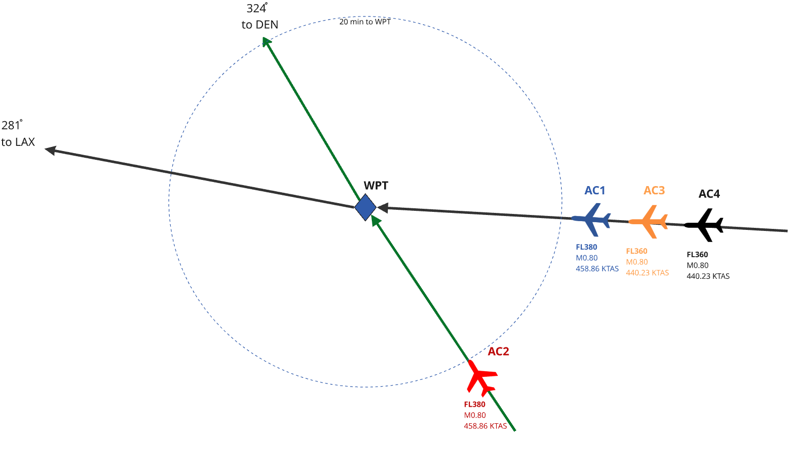
Project Overview
Build a reference System of Systems (SOS) MBSE architecture for how intent is managed across the National Airspace System (NAS) .
Investigate how information fidelity impacts stakeholder tradeoffs under disruption and recovery events
Two Claims:
  Higher fidelity = Higher Optimality
  MBSE can identify the issue
2
Notes:
Two claims are central to the project. The first, explored by experiment, is that replacing a low-fidelity rule of thumb with a higher-fidelity model fed by accurate aircraft performance and informed of the broader state of the airspace can and will lead to changes in how disruptions are mitigated. The second, shown by modeling, is that an MBSE architecture can locate that interface, name who owns the decision and the data, state the unmet requirement, and lets the scoring model's fidelity be swapped (conceptual, nominal mass, actual mass) with the structure unchanged. As such, the model contributes as a traceable representation of how strategic objectives become executable aircraft behavior.

Slide 3
Project Scope and Deliverables
Project Scope:
Stakeholder needs & requirements
System Requirements
Architecture Definition (context, IBDs, activity, & sequence diagrams)
System Analysis
Verification & Validation
Deliverables
  SysML v2 Model
  Comprehensive Project Report

Slide 4
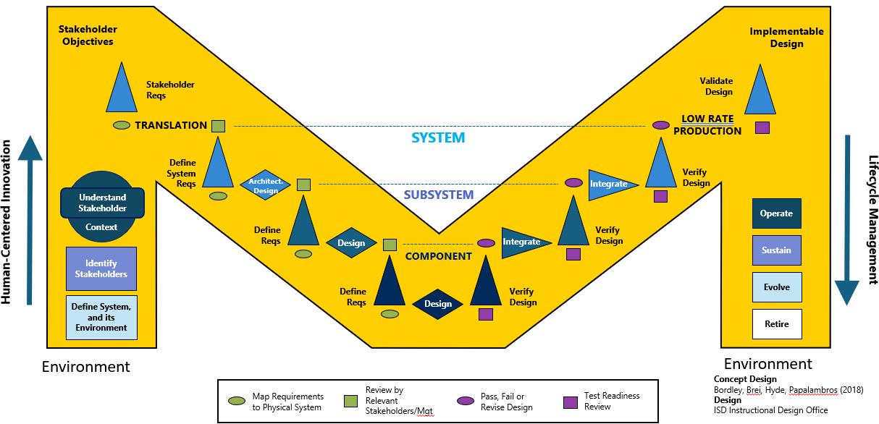
Methodology
Model Based Systems Engineering – use SysMLv2 within VS Code to create complete validation of conflict resolution.
Simulation of example use case & activity

Slide 5
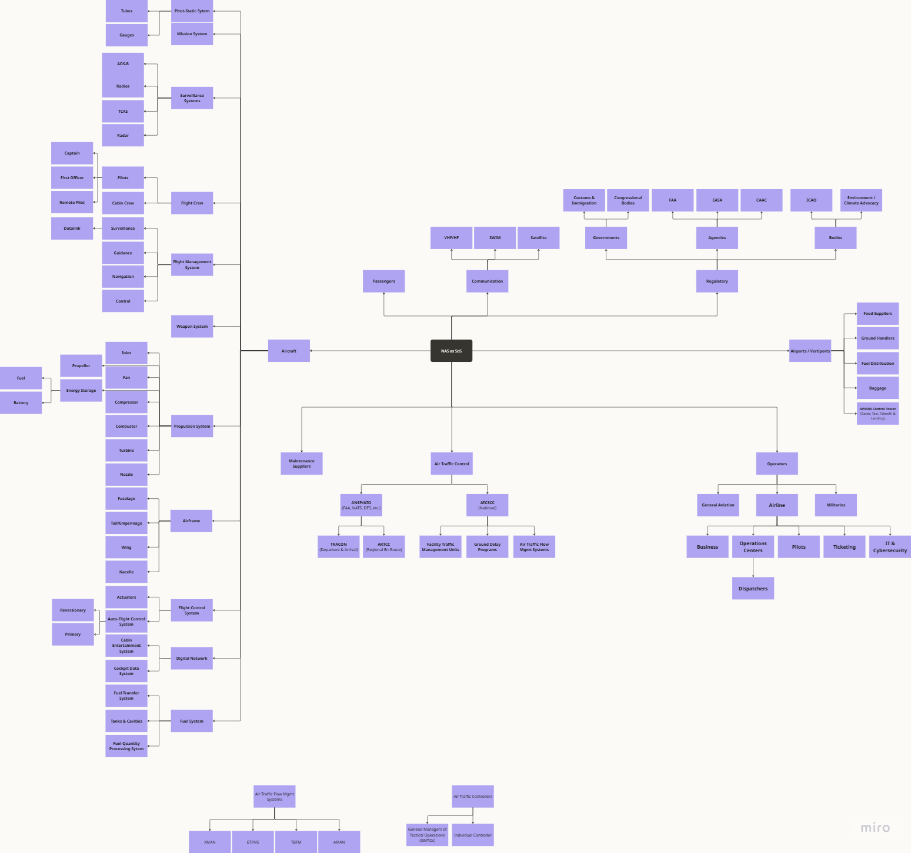
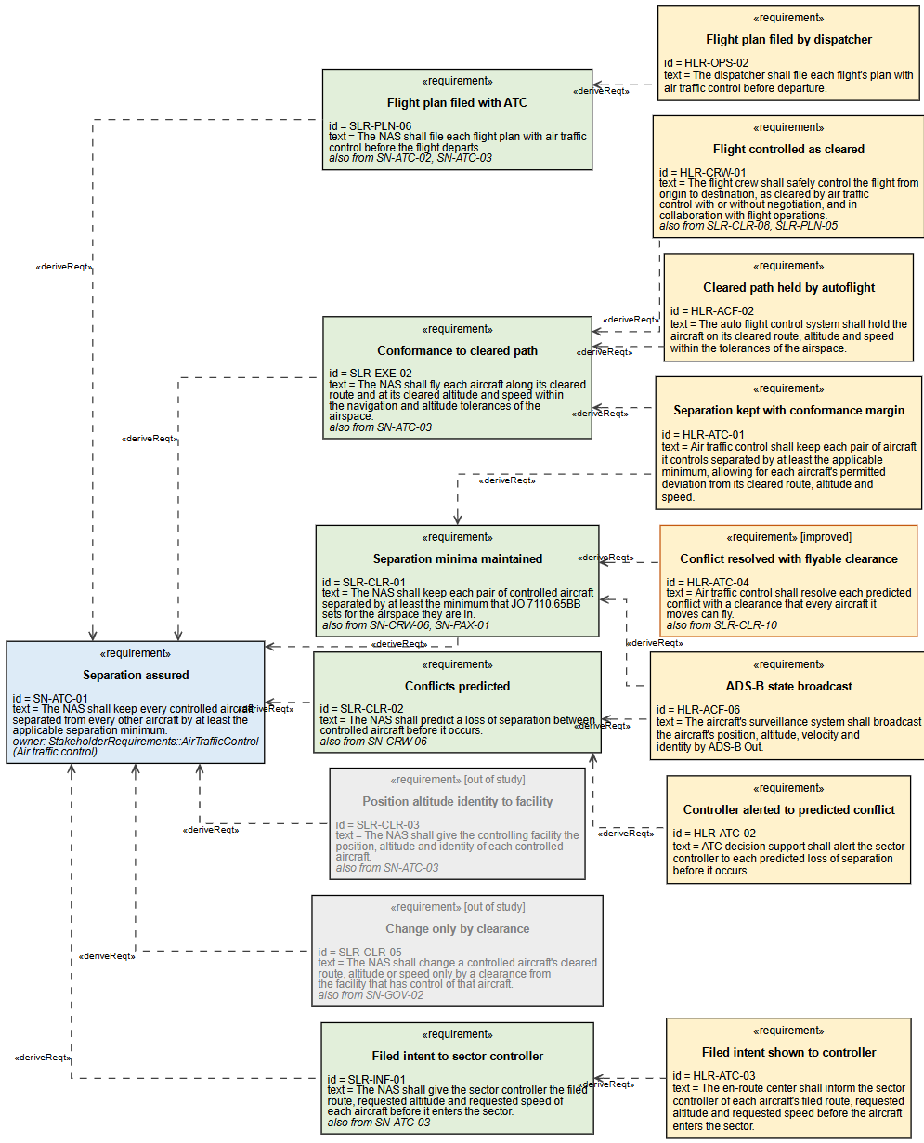
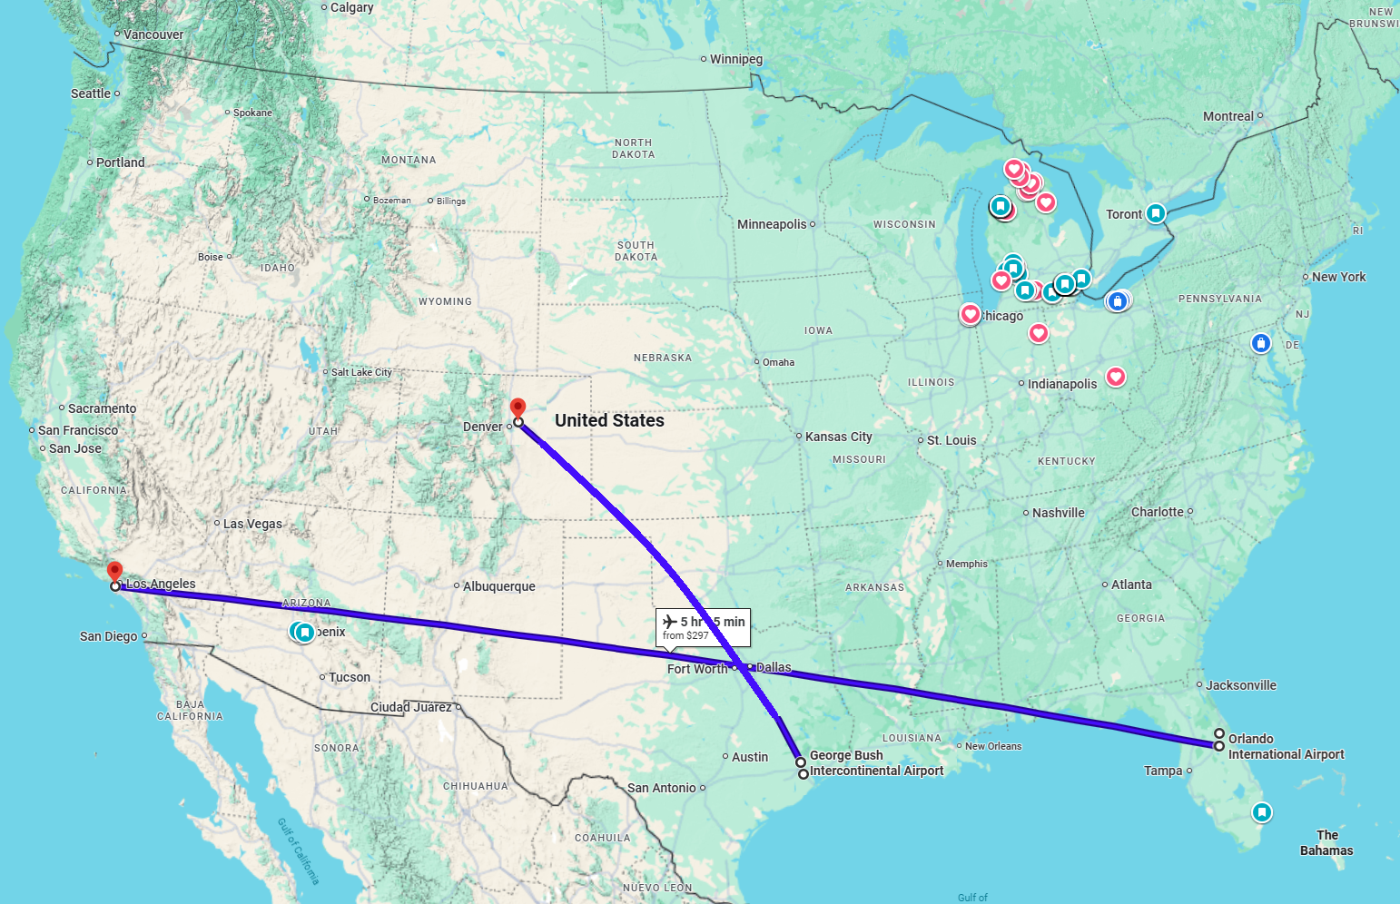
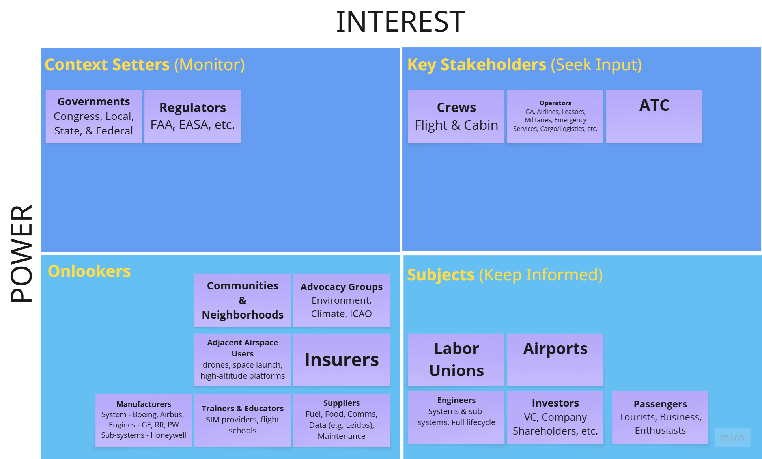
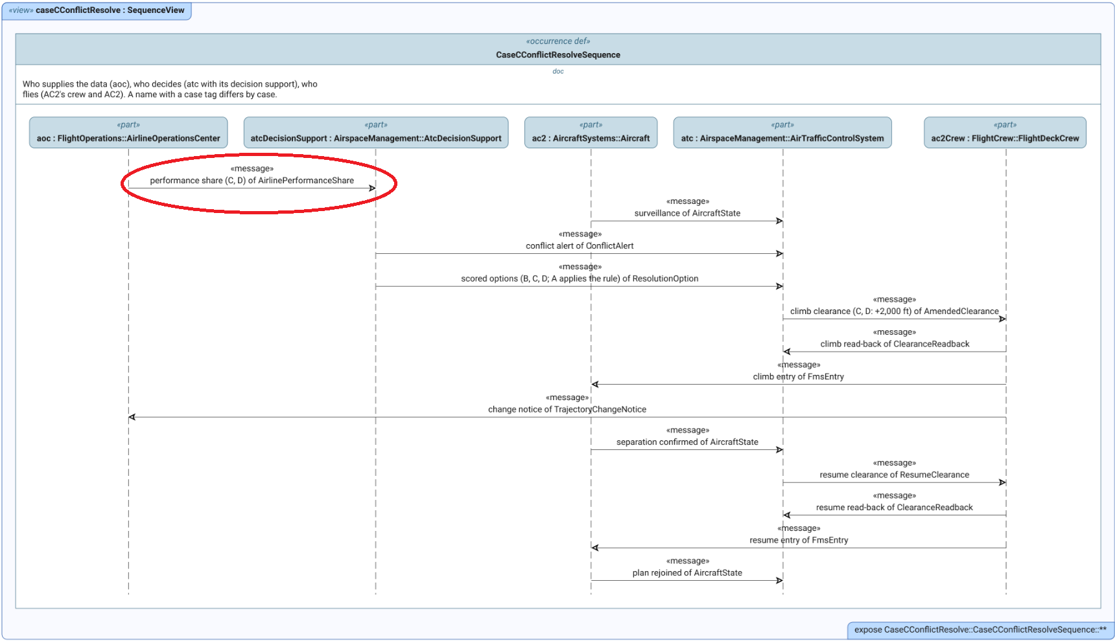
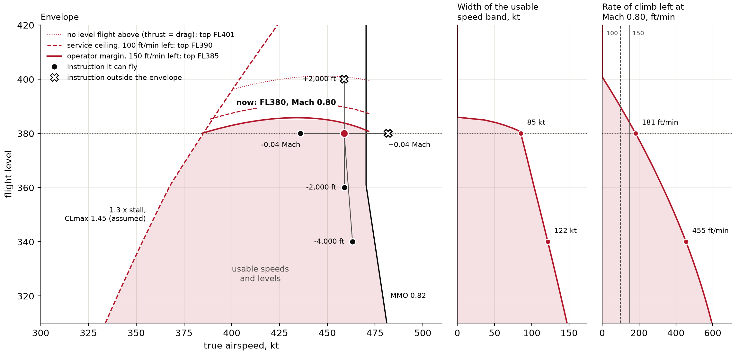
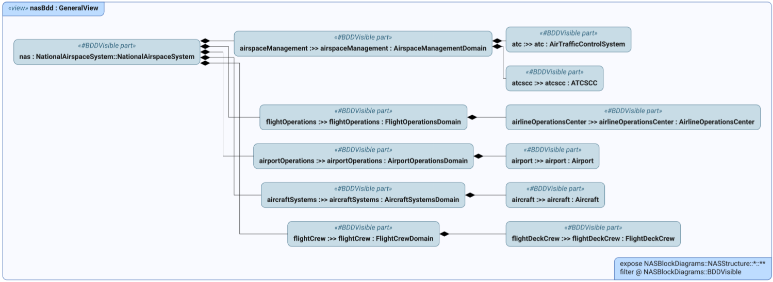
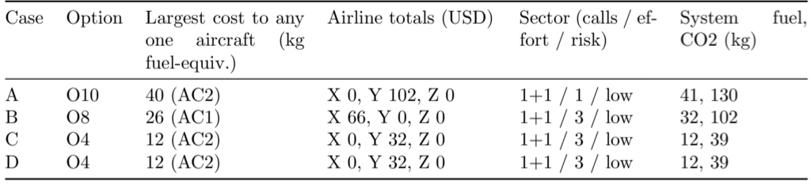
Preliminary Results
Flight Envelope Restrictions of Boeing 737-MAX 9 at FL380
Stakeholders & their objectives identified
Constituent systems determined
SLRs through HLRs developed
Models of all systems created
Information gap identified
Three Alternative Approaches Tested

Slide 6
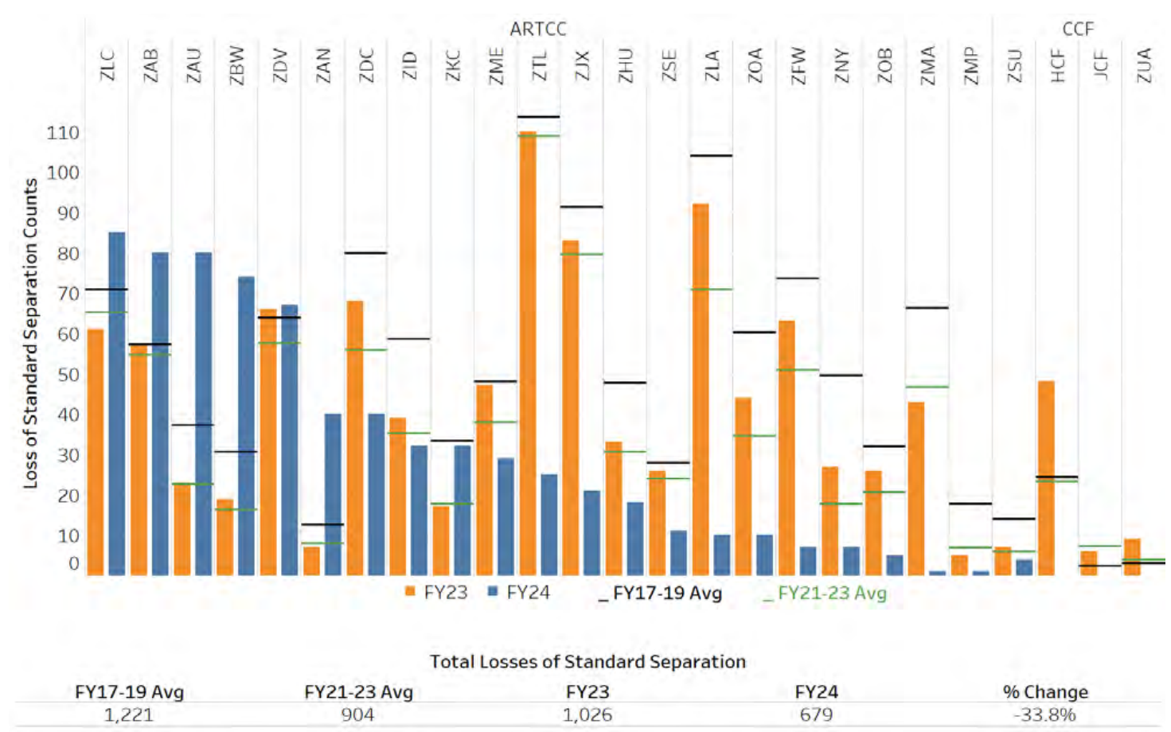
Project Benefits
One example conflict vs. today's rule – 70% reductions in:
  Per-aircraft cost
  Per-airline cost
Overall system fuel expenditure and emissions
Additional Considerations:
  Increases controller workload
  Requires airlines to provide ship-specific data
100s of separation losses per year, despite ATC interventions
FAA Air Traffic by the Numbers FY2024, p. 33
Notes:
Per aircraft cost ensures measures of pilot performance aren’t affected, which would be met with resistance from flight crews.
Per airline costs ensures there is incentive to provide performance data, and take on costs of security and transmission.
Overall fuel & emissions reduction helps to achieve national goals and ensure longevity.

Slide 7
Thank you!
Forever, Go Blue!

Slide 9
Optimizing Workflow and Efficiency in General Assembly
EXAMPLE
Student Name

Slide 10

Project Overview - Example
Enhance efficiency of the General Assembly lines
  Maximize productivity
  Ensure seamless operations
  Improve throughput
  Improve customer satisfaction
Currently assembly line design is
creating uneven workload distribution
  Target rebalancing of workstations to reduce cycle times and align to takt time of 240 seconds
Internal stakeholders: management, line workers, process engineers, operations engineers
External stakeholders: customers and shareholders/investors
10

Slide 11
Project Scope and Deliverables - Example
Scope
  Rebalancing of all workstations within the General Assembly lines
Deliverables
  Balanced Line Layout Proposal
  Validated Trial Plan for Implementation
  Comprehensive Project Report

Slide 12
Methodology - Example
Define
Measure
Analyze
Improve
Control
Video Recording Time Studies
MODAPTS Time Studies
YAMAZUMI Rebalancing Charts
Pilot Trials for Improvement

Slide 13
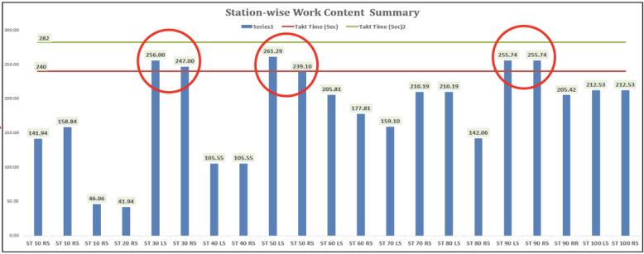
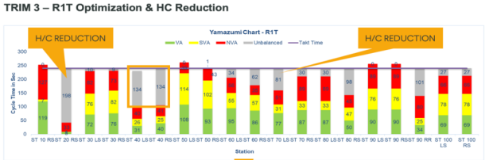
Preliminary Results - Example
Trim 3 General Assembly Rebalance
  Shift operations from 40LS to 30LS
  Reallocate operations at 70LS
  Shift operation from 90RF to 80RS
Trim 3 Headcount Reduction
  $200,000 cost savings

Slide 14
Project Benefits - Example
Increased Efficiency
  Reduced bottlenecks and delays
  30LS cycle time reduction of 23%
  40LS cycle time reduction of 19%
Headcount Reduction Cost Savings: $200,000
Other Benefits
  Improved throughput
    Ability to meet production demands by adjusting process time to takt
  Streamlined Material Flow
  Enhanced Customer Satisfaction
  Investor Confidence

